Slide 1

Could This be The Terminal Generation?

Slide 2
FACTUAL EVIDENCE WE DARE NOT IGNORE

Slide 3

FACT 1:
Israel’s Rebirth
Jesus promised it!
Prophets predicted it!

Slide 4
MATTHEW 24:32-35
NAS

Slide 5
32 “Now learn the parable from the fig tree: when its branch has already become tender and puts forth its leaves, you know that summer is near; 33 even so, you too, when you see all these things, recognize that He is near, right at the door. 34 Truly I say to you, this generation will not pass away until all these things take place. 35 Heaven and earth will pass away, but My words shall not pass away.”

Slide 6
I found Israel like grapes in the wilderness; I saw your forefathers as the earliest fruit on the fig tree in its first season. Hosea 9:10

Slide 7
It has made my vine a waste And my fig tree splinters. It has stripped them bare and cast them away; Their branches have become white.
Joel 1:7

Slide 8
How Long is a Generation?
40 years?
70 years?
Genesis 15:13,16:
100 years

Slide 9
The whole world should be turning against Israel!
² “Behold, I am going to make Jerusalem a cup that causes reeling to all the peoples around; and when the siege is against Jerusalem, it will also be against Judah. ³ It will come about in that day that I will make Jerusalem a heavy stone for all the peoples; all who lift it will be severely injured. And all the nations of the earth will be gathered against it.
Zech 12:2-4

Slide 10
BDS Movement
UC Davis:
Jew-hating thugs painted swastikas on a Jewish fraternity house. Jewish students on campus have also been harangued by Muslims screaming “Allahu Akbar,” the war cry of jihad.
VP Biden tells Jews they are only safe in Israel.
Bibi tells French Jews it is time to come home!.
More Jews in Israel than America

Slide 11
UN adopts 20 resolutions against Israel, 3 on rest of the world!
Syria/Iran/N. Korea
2015-2016 UNGA Resolutions
(70th Session)
Condemning Countries

Slide 12
What’s Driving this Hatred of Jews?
Replacement Theology!

Slide 13
FACT 2:
Tech Explosion

Slide 14
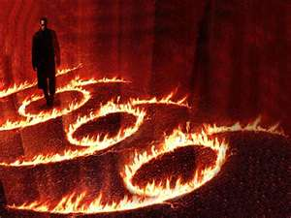
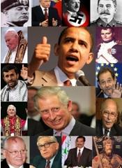

Slide 15

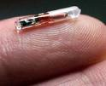
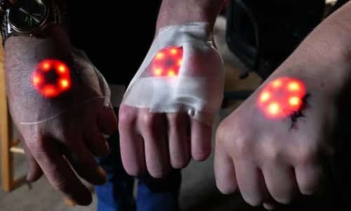
Biometrics
Near Field Communication

Slide 16


Slide 17

FACT 3:
Terrorism

Slide 18
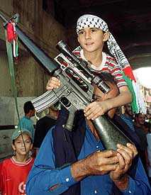
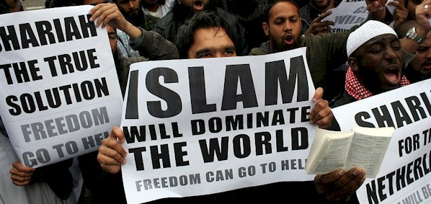
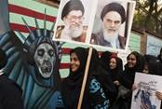

Slide 19

FACT 4:
The Death of
America

Slide 20
America is Imploding:
*Greed
*Abortion
*Perversion
*Spiritual/Political Apathy

Slide 21
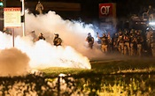
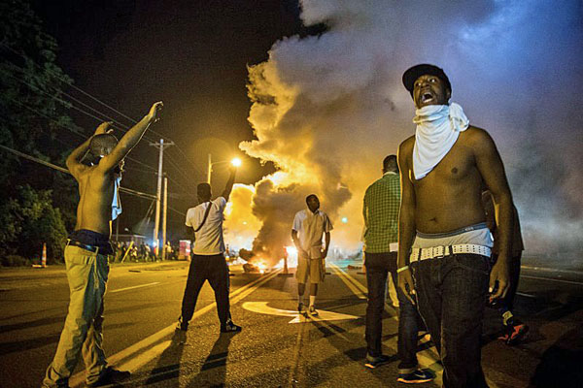
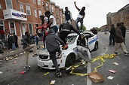
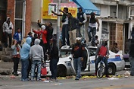
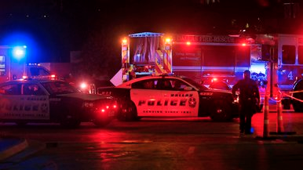
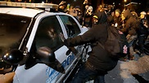
The New Face of America

Slide 22
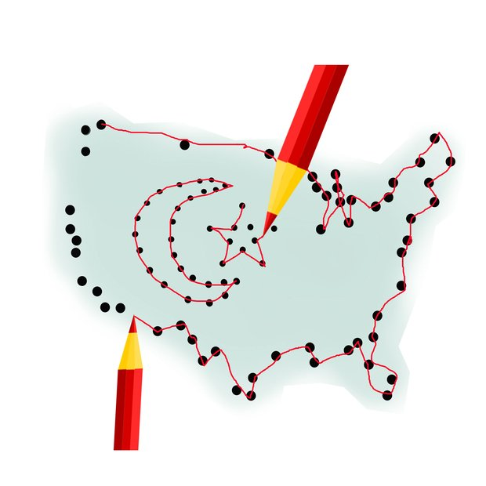

But the Spirit explicitly says that in later times some will fall away from the faith, paying attention to deceitful spirits and doctrines of demons.
1 Tim 4:1
For the time will come when they will not endure sound doctrine; but wanting to have their ears tickled, they will accumulate for themselves teachers in accordance to their own desires; and will turn away their ears from the truth, and will turn aside to myths. 2 Tim 4:3-4

Slide 23
Download a free copy
garyfrazier.com

Slide 24

www.garyfrazier.com
Click the “Blog” tab for Gary’s blogs
Follow on TWITTER
@garyfrazier7
Like us on FACEBOOK

